Slide 1
Day Two Services®
The Higginbotham Difference
06-06-24
EMPLOYEE BENEFITS
Lead with Values and Value Leads.

Slide 2
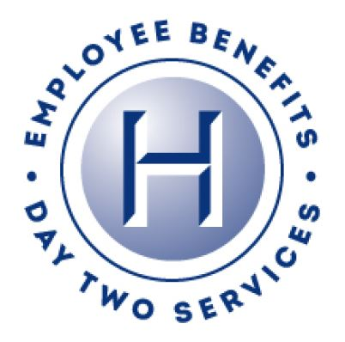
Resources
Day Two Services®
COMPLIANCE
COBRA Administration
5500 Reporting
CDHP Administration
HR Services/Consulting
HR Technology Consulting
EMPLOYEE ENGAGEMENT
Strategic Communications
Online Benefits Administration & Consulting
Employee Response Center
COST
Health Risk Management
Financial and Clinical Analysis
Retirement Plan Services/Executive Life/Executive Compensation
Global Capabilities

Slide 3
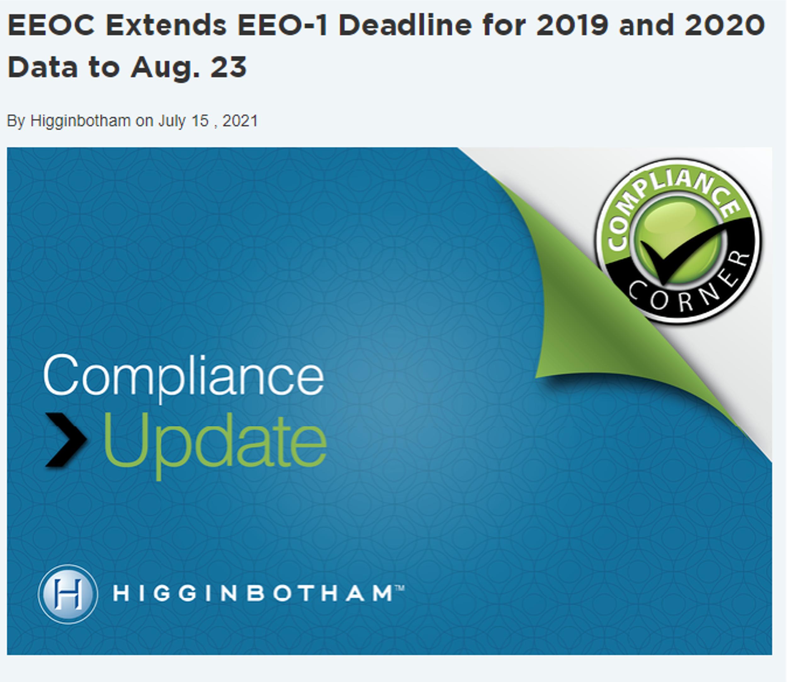
Compliance
Day Two Services®
GUIDANCE
In-house legal
Audit support services
Compliance reviews
HR/legislative updates
ERISA/ACA/HIPAA/COBRA/FMLA, etc. compliance/interpretation
TOOLS AND SERVICES
§105(h) and §125 nondiscrimination testing
§414 controlled group analysis
ERISA documentation
5500 preparation
COBRA administration

Slide 4
HR Technology Consulting
Day Two Services®
Review client’s current HR technologies and workflows to ascertain efficiencies and gaps to maximize existing products
Review client’s current HR technology pricing to ensure competitiveness
Assist with selecting the right HR technology for payroll, time keeping, HRIS, benefits administration, performance management, recruitment/applicant tracking, and onboarding
IDEAL CLIENT/PROSPECT
An employer with more than 100 employees and has one of the following:
Payroll or benefits administration issues with the current provider (poor service or performance)
Has been with the current provider for over five years, pricing may be high
Is handling the tracking of ACA manually
Is tracking benefits manually or entering data into the carrier’s websites
Is tracking time manually and does not know how many Full Time Equivalent Employees it has

Slide 5
Mineral (ThinkHR)
Day Two Services®
Real Answers from Real Experts
There's simply no substitute for human experience and knowledge. Enjoy unlimited, immediate access to certified, experienced advisors to help navigate your people risk management issues.
Train Your Staff (and Yourself!)
Whether you train because you have to or because it's just a really good idea, we've got you covered with a full-featured learning management system with the industry's most comprehensive unlimited training catalog.
A Living Handbook
The industry's only wizard-based handbook tool covering all 50 states, complete with policy change alerts to ensure your handbook is always up-to-date, accurate, and protecting your business as effectively as possible.
Content You can Rely On
Fully-integrated content combined with expert analysis or employment laws and regulations and best practice information to help you handle current issues and to better understand how to prepare for future issues.
Stay Ahead of the Curve
You have enough on your plate just dealing with today's issues! Our team of attorneys and experts monitor and anticipate future challenges and prepare you through email and CE accredited webinars.
Tools, Forms, and Templates
Thousands of templates, tools, checklists, and policies to make your job easier. Resources include FLSA classification, performance management, salary benchmarking, interactive audits. job description builder, and more.

Slide 6
CDHP Administration
Day Two Services®
§125 Health FSA/dependent care accounts:
• Full service, turn-key administration
• Custom branded cards
• Employer/employee portal
• Customer service center
HRA plans:
• QSEHRAs
• ICHRAs
HSA
HRA
FSA
6

Slide 7
Employee Engagement
Employees’ Top Preferred Channels for Benefits Education
Day Two Services®
Employees who say their employer’s benefits communications are easy to understand are…
99% more likely to feel valued or appreciated.
67% more likely to feel successful.
41% more likely to be productive.
When employees understand how their benefits work through their employer’s benefits communications, they’re…
100% more likely to trust their employer’s leadership.
78% more likely to be happy with their job.
50% more likely to be loyal to their employer.
And yet, nearly a third of employees (31%) don’t think their employer's benefit communications are easy to understand.
More than half of employees (55%) wish they were more informed about their benefits so that they could get more value from them.
50%
Online Portal
41%
Email
30%
In-Person
17%
Over the Phone
18%
Mobile App
*Source: 2021 MetLife EB Survey

Slide 8
Employee Response Center
Day Two Services®
Open enrollment support
Year-round enrollment support
Benefit eligibility administration and verification
Benefit claims assistance and resolution
Customized call reports
Dedicated toll-free number available (group size dependent)
140+ languages available
System enrollments based on access
Bilingual enrollment meeting support
8

Slide 9
Communications
Day Two Services®
Benefits & HR Branding Development
Team:
Consultants
Benefit specialists
Graphic designers
Creative/technical writers
Capabilities:
Strategic communication planning to convey client messages
Customized, branded communication to inform and engage
Targeted materials for education, enrollment, wellness initiatives and total
Compensation statements
Comprehensive recruiting and retention tools
Results and ongoing needs monitored
Health Care Reform Education
Benefits Guides
Employee
Surveys
Open Enrollment Presentation
Recruitment Tools
Web-based Communications
Benefit Statements

Slide 10
Communications
Day Two Services®
Comprehensive, User-Friendly Materials:
Logo design/identity branding
Memos/letters/instructions
Payroll stuffers/posters/postcards
Benefit/recruiting summaries
Announcements/newsletters
Enrollment guides
Wallet cards/envelopes
Wellness communications
Special mailings/fulfillment
Promotional materials (magnets, key fobs, etc.)
Translation
Electronic – interactive PDFs, benefit portal branding
Social Media – LinkedIn, Twitter, Facebook, blog
Total compensation statements

Slide 11
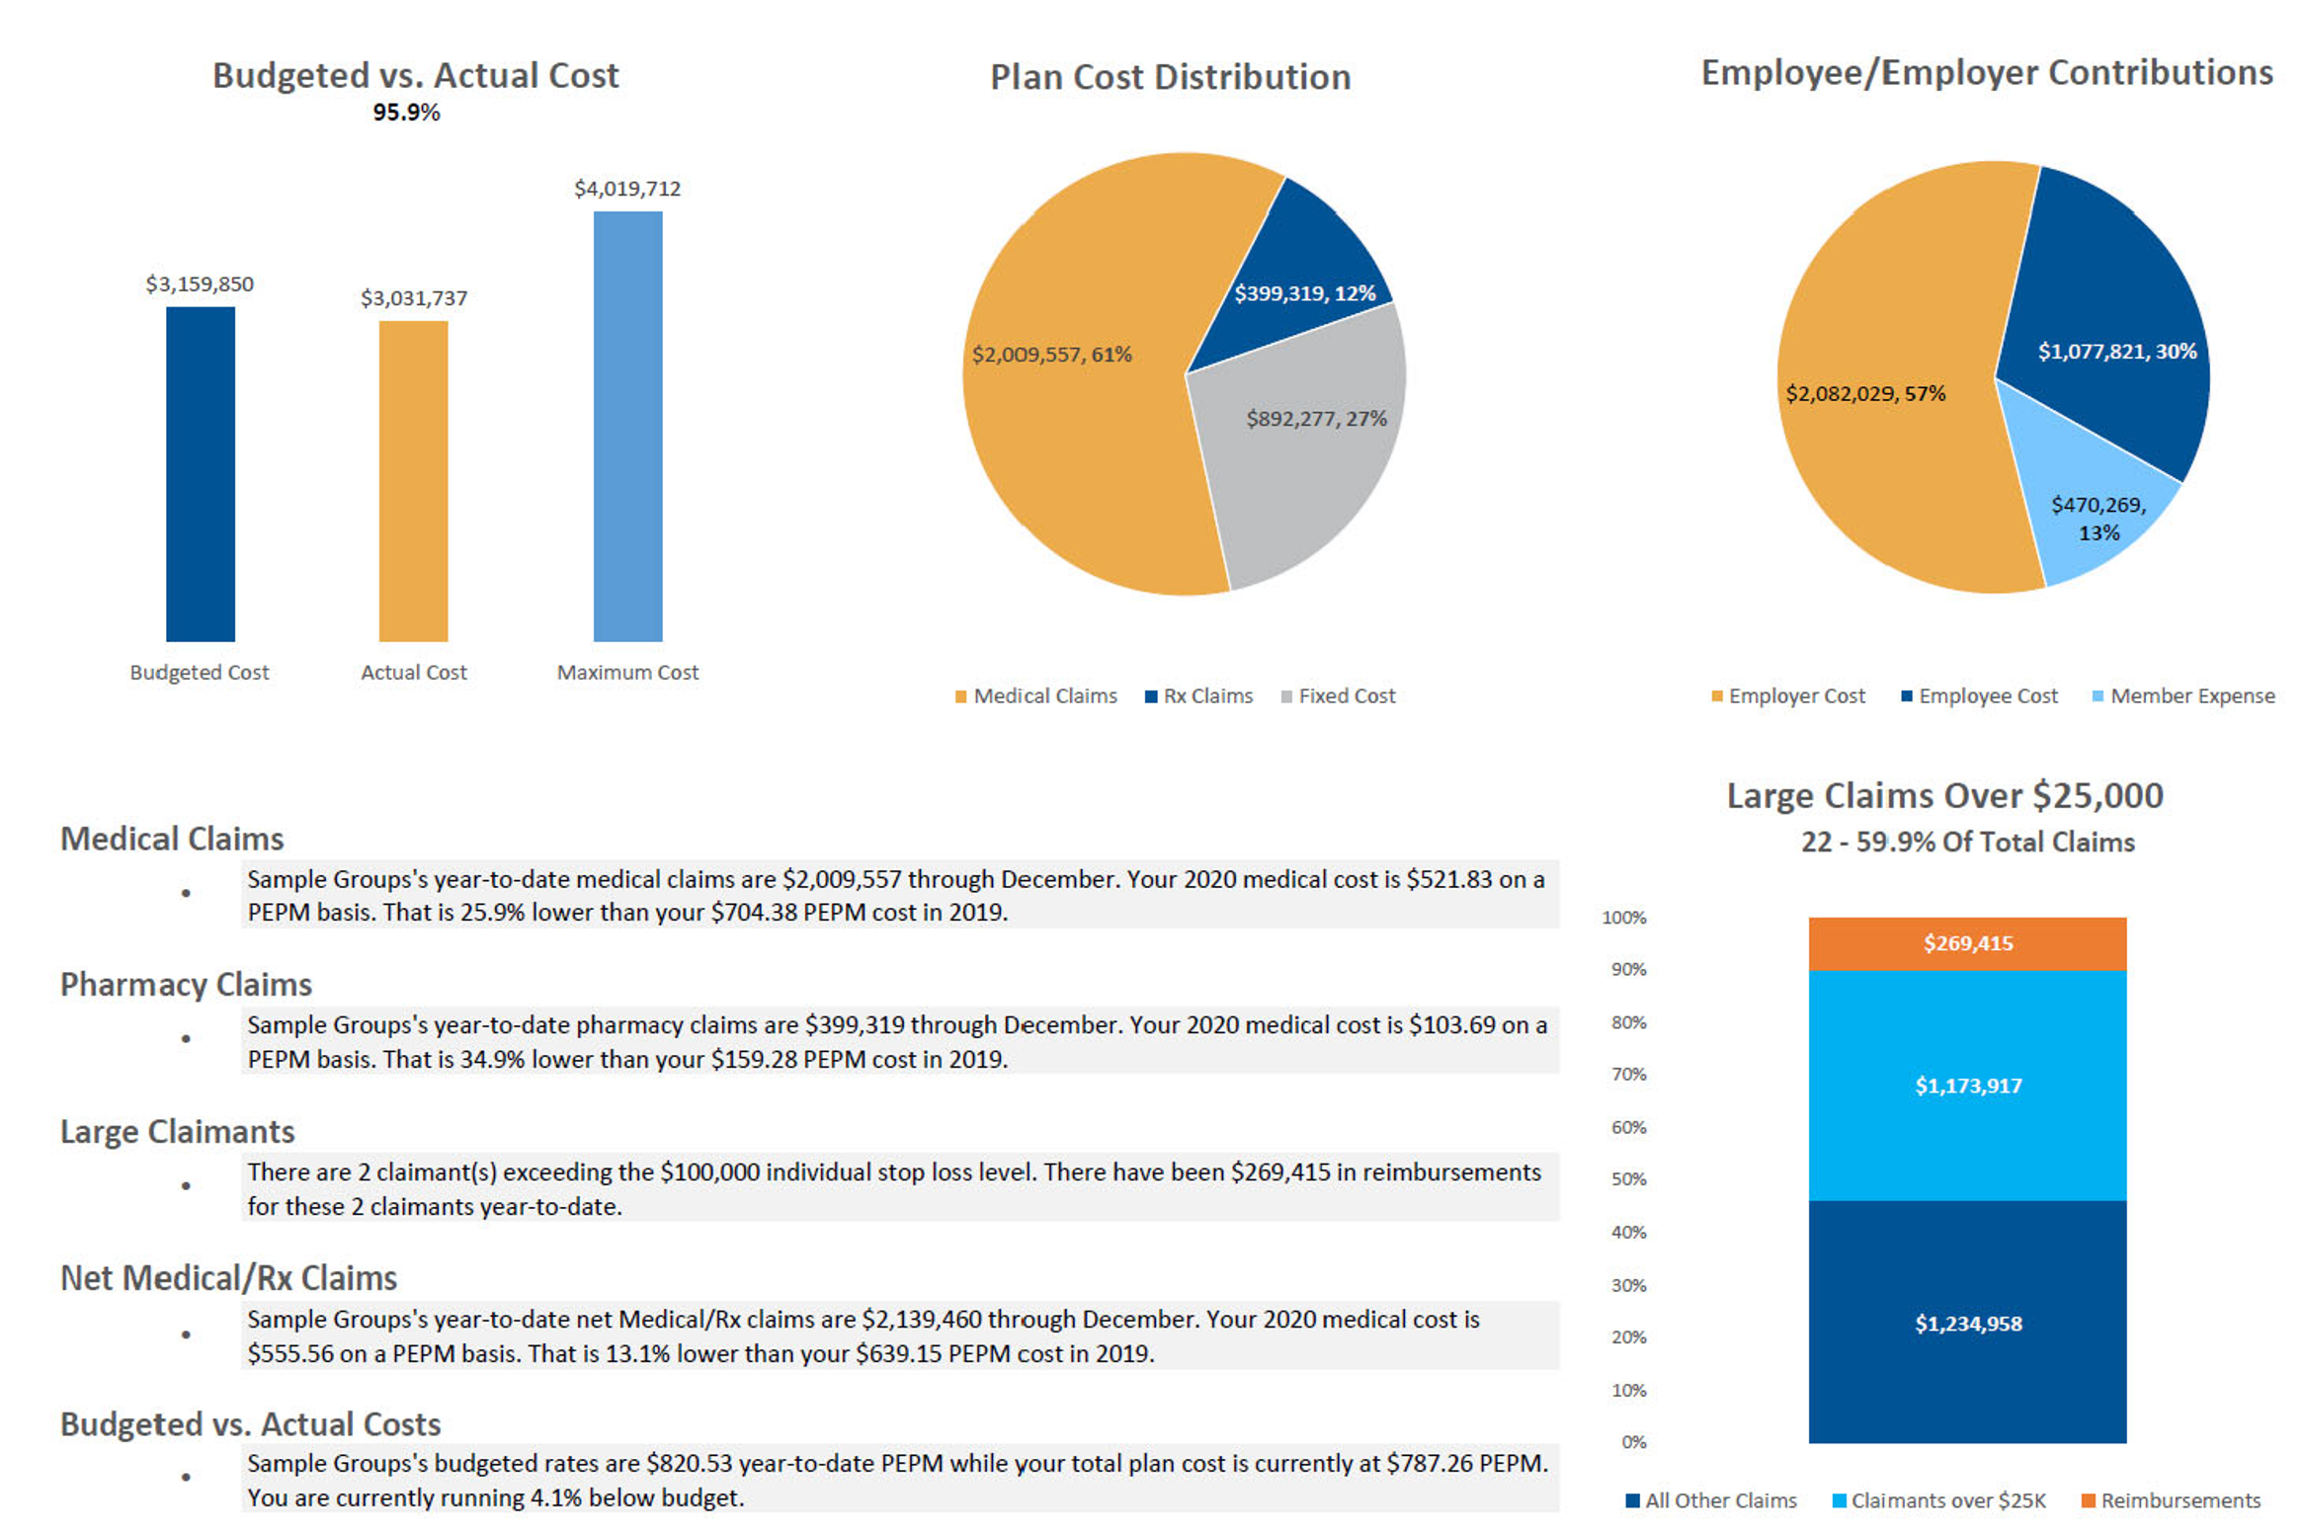
Financial Analysis
Day Two Services®
Consulting for employer groups with self-insured group medical insurance programs to assist them in the financial management of the plans
The scope of these engagements includes pricing, reserving and the development of an employee contribution strategy
Perform group long-term disability reserve and IBNR valuations for self-insured employers and captive insurance companies
Evaluate incumbent renewal offering to make sure the proposal is competitive
Project what a group might expect for its upcoming renewal before it is released
Calculate reserves for ASOs

Slide 12
Clinical Analysis
Day Two Services®
Our data analytics risk engine custom built for population health management needs.
Granular data views and analysis helps clients understand costs, care delivery and quality at the individual level, as a company, and compared to other companies or similar industries
View limitless variations of claims data via information-rich charts and graphs
Revolutionary predictive modeling – calculate conditions, care gaps, hospital admissions, as well as readmissions 6 to 12 months in advanceMitigate risk through evidence-based action plans that make sense
12

Slide 13
Health Risk Management (HRM)
Day Two Services®
Professionals with Varying Backgrounds:
Population Health Management
Health Education
Corporate Wellness
Exercise and Sports Physiology
Nutritional Sciences
Psychology & Mental Health
Social Work
Public Health
Overall Goal:
Cost containment + risk mitigation = lower premiums from fewer/less expensive claims
Programs are customized to each client’s goals, population and budget
Program design can range from basic (newsletters) to robust (outcomes-based program)
Full range of services from design and implementation to participation and compliance evaluation, with both short-term and long-term goals in mind, coaching, etc.
Data Integration
Stratification
Population Identification
Measurement
Community
Care Delivery System
Health Plans/Payers

Slide 14
Health Risk Management (HRM)
Day Two Services®
PROCESS
Strategic Analysis – determine demographics, culture, barriers, management support, needs, goals, budget, etc.; provides the capability for a highly customizable approach
Surveys – customizable; use results to demonstrate demand to leadership and build program with employee feedback
Screenings and/or health assessment – aggregate reporting allows us to determine top three areas of focus
Tools – newsletters, webinars/seminars, challenges, coaching, etc.; policy and communication templates are available
Increased Employee Morale
Reduced Employee Sick Time
Reduced
Staff
Turnover (Higher Commitment)
Benefits of a Healthy Workplace
Improved Company Image
Reduced Presenteeism
Increased Productivity Levels
14

Slide 15
Enrollment Solutions/BiH
Day Two Services®
BenefitsInHand (BiH) is our in-house ben admin solution:
Open enrollment, new hire/newly eligible enrollment, life
Events, reporting, PTO tracking, onboarding, decision
Support, defined contribution and total compensation
Statements
ACA module for variable hour tracking and 1094/1095
Reporting for both self funded and fully insured clients*
EDI carrier feeds available for medical, dental and vision, etc.
Payroll feeds continuing to be added
Allsynx:
Separate in-house ben admin solution – more info coming
15

Slide 16
HR Services
Day Two Services®
Multiple HR Professionals
Grow HR consulting
Management training and speaking
Investigations/audits
Workplace safety
Employee handbooks
Executive searches
Multiple HR Professionals
Real HR outsourcing/insourcing
16

Slide 17
HR Services
Day Two Services®
Multiple Professionals/Disciplines
Qualified/non-qualified plans
401(k)/403(b)/DB plans
Executive compensation/deferred compensation
Key Man/Buy-Sell Agreements
Estate planning
Wealth Preservation Plan/ParadigmPlan
Maintain reasonable expenses
Support you to maintain a financially healthy workforce
Identify and mitigate potential conflicts of interest
01
06
02
05
03
Help your participants to retire
Create a system of checks and balances for you
04
Increase your participation and savings rate

Slide 18
Thank You!
Ross Carmichael
Managing Director of Compliance and Operations
rcarmichael@higginbotham.com
Higginbotham.com

