Slide 1
Visual Style for this year’s Powerpoint
2016 DECEMBER MANAGEMENT MEETING

Slide 2
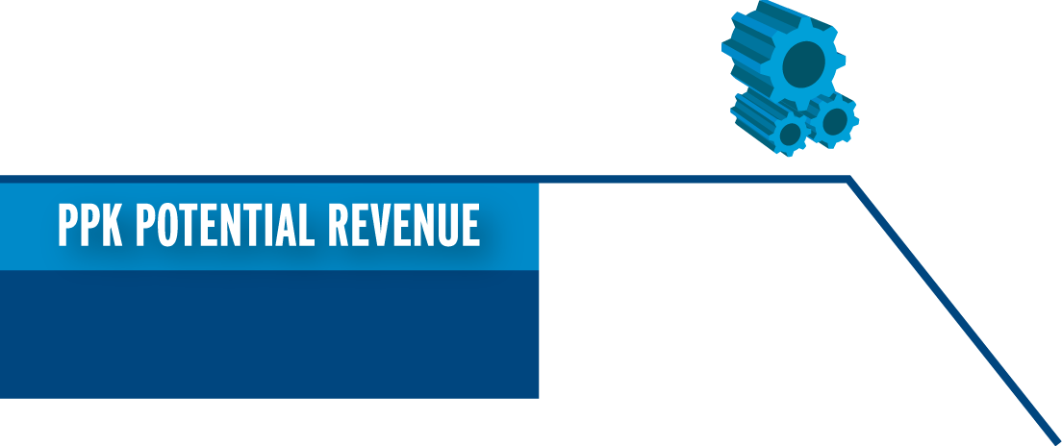
Building Our Brand Together
Visual Style for this year’s Powerpoint
Integrated Extrudable
Total Potential Revenue: $1.6 Billion!
$189 MILLION
Aerosol
Packaging Enablers
$428 MILLION
$134 MILLION
Pet (animal) Food
$96 MILLION
Nutraceutical
$58 MILLION
Gas Barrier
$715 MILLION
Notes:
Each of these market segments provide us with great growth opportunity. Their potential for Plastipak is tremendous! Over $1.6 Billion in additional global revenue!
I want to thank Dick Darr for his CTM leadership. I also want to thank Marc Pedmo and Bob McIntire who currently lead the CTM process. And finally, I would like to thank everyone on the CTM Team.

Slide 3
Key Global Activities 2016
Visual Style for this year’s Powerpoint
Growth Through Expansion
Notes:
As part of Plastipak’s global strategy, we continue to expand our business.
New locations in North America, South America, Europe, Africa and Asia represent an investment in our future.
Sorry that we haven’t got to Australia and Antarctica yet!

Slide 4
Key Global Activities 2015
Visual Style for this year’s Powerpoint
Notes:
Through the efforts of everyone in this room, Plastipak is recognized as an industry leader.
I believe talent is a key driver in separating us from our competition.
How do we continue to leverage this advantage?

Slide 5
Notes:
Let’s talk about intuition and how it is changing.
Intuition is our confidence in decision making.
In a world where the speed of change is accelerating, it becomes more difficult to use our intuition to make decisions. This is because past experience is less relevant to future decision making.
Let’s look at some examples that demonstrate high speed of change.

Slide 6
Analytics & Business Insight
Notes:
Because change is happening so fast, it is becoming more difficult to rely on intuition.
This year we are creating an analytics function for better and faster decision making.
This will allow us to acquire, analyze and transform data into insightful models and actionable information.

Slide 7
Financial Data
Notes:
Let’s turn to finances.
The true measure of a company’s success is its financial performance.
Let me share some of our financial data with you this morning.

Slide 8
2016 Performance
B3
Credit Score
CAA1
*Moody’s Bond Rating
Notes:
I want to thank all of you who worked hard to obtain this financial performance.
It has resulted in the financial community recognizing our performance with an improved credit rating.
Good work by Mike Plotzke, Pradeep Modi and their teams!
Next up, a rating of B2!

Slide 9
Mr. Young
Please redo graphics
BPM
2017
Business performance measures
Notes:
As you know, each year, I present my major focus areas for the next twelve months.
This is presented annually to our board of directors.
Let me take you though some of the highlights.

Slide 10
Questions
Please redo graphics
Notes:
TURN UP THE LIGHTS, PLEASE!
I have allocated a few minutes for questions this morning. Does anyone have something they would like to ask?
(WAIT FOR AT LEAST 15 SECONDS BEFORE CONTINUING IF NO QUESTIONS)
If not, then thank you and happy holidays!

